Slide 1




Clients
Server
Internet
Backend Server Script
SQLAlchemy Database
The Knotty Chat Client Script

Slide 2
D_{k}(C_{n}):
XX | XX | XX | XX | XX | XX | XX | XX
⊕
Block’:
AB | 01 | 4F | 21 | 00 | 7C | 02 | 9E
=
Encoded Data:
XX | XX | XX | XX | XX | XX | XX | XX

Slide 3
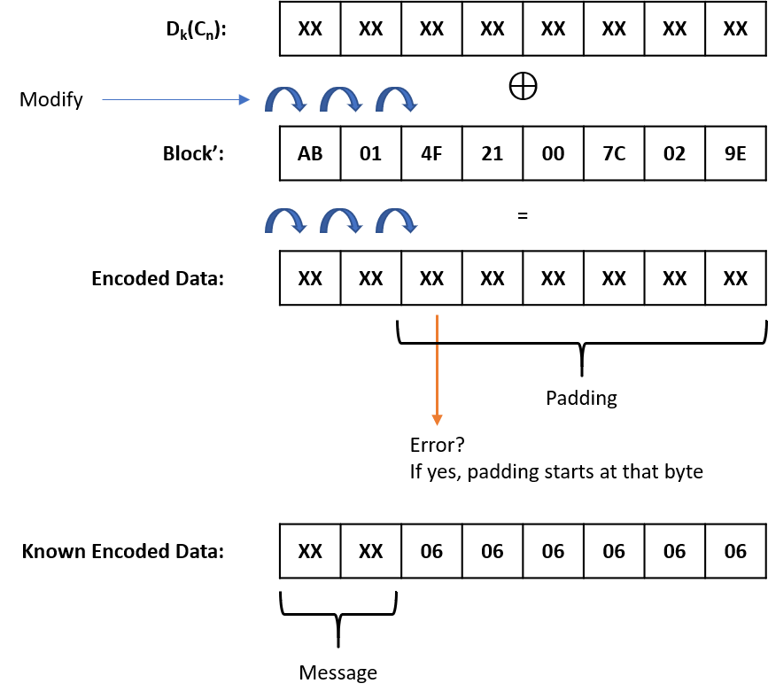

Slide 4
D_{k}(C_{n}):
XX | XX | XX | XX | XX | XX | XX | XX
i^{th} byte of Block’ | Previous Value | Operation* | Modified Value
8 | 9E | 9E ⊕ 06 ⊕ 07 | 9F
7 | 02 | 02 ⊕ 06 ⊕ 07 | 03
6 | 7C | 7C ⊕ 06 ⊕ 07 | 7D
5 | 00 | 00 ⊕ 06 ⊕ 07 | 01
4 | 21 | 21 ⊕ 06 ⊕ 07 | 20
3 | 4F | 4F ⊕ 06 ⊕ 07 | 4E
*Increase the original padding of ‘06’ to ‘07’
Modify
⊕
Block’:
AB | 00 | 4E | 20 | 01 | 7D | 03 | 9F
=
Encoded Data:
XX | XX | 07 | 07 | 07 | 07 | 07 | 07
Error? If no, decryption succeeded
If yes, increase the value of the modified byte by 1 in block’
Expected Encoded Data:
XX | 07 | 07 | 07 | 07 | 07 | 07 | 07

